Slide 1

8010 Lending Co
Damola A. Adeniji
Debdattaa Kar
Jyoti Chavan
Srujana Sirimala
Osayi Omorodion
Yaritzy Juarez

Slide 2

Business Context
Company
Direct residential mortgage lender
Project Goal
Underwriting process expedition

Slide 3


Business Context (Cont.) Organizational KPIs
Ratio of Jumbo/Conforming Loans
Revenue Growth YoY
Profit Growth YoY
Proportion of loans that exceeds conforming loans

Slide 4

PROCESS
Nature of the Service
Mortgage Underwriting Process
Initiation
Expected Outcome
When we Receive Loan Application
Approve or Decline Loan Application

Slide 5
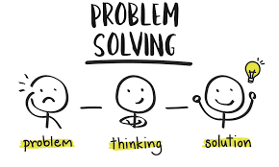
Identify Customer & Customers PTBS
Customer
Prospective Homeowner
Core Problem (PTBS)
Enhancing Quality of Life

Slide 6
OPERATIONAL METRICS
Underwriting Process Lead Time
Cost of Underwriting Process per application
Document Verification Cycle Time
VALUE METRICS
Underwriting Process Lead Time
Loan Funding Turn Around Time

Slide 7
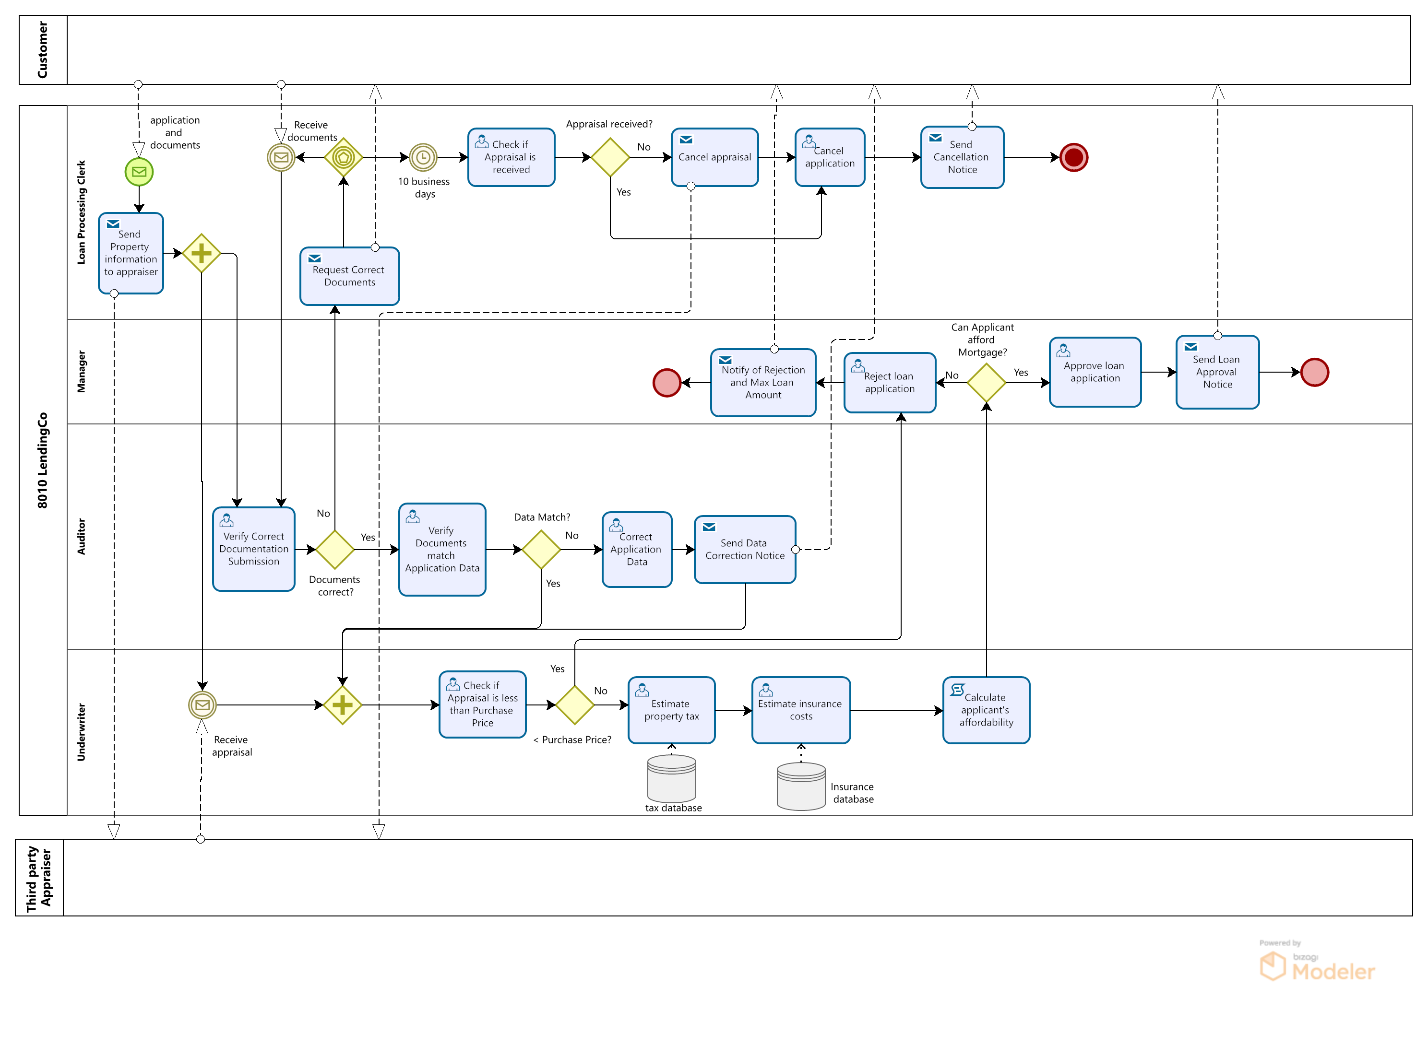
As-is BUSINESS PROCESS

Slide 8
AS-IS BUSINESS PROCESS – PAIN POINTS
As-is BUSINESS PROCESS
No customer interaction
Reliance on Human intervention
Reliance on human intervention
Affordability calculated at later stage
Tasks sequentially executed

Slide 9
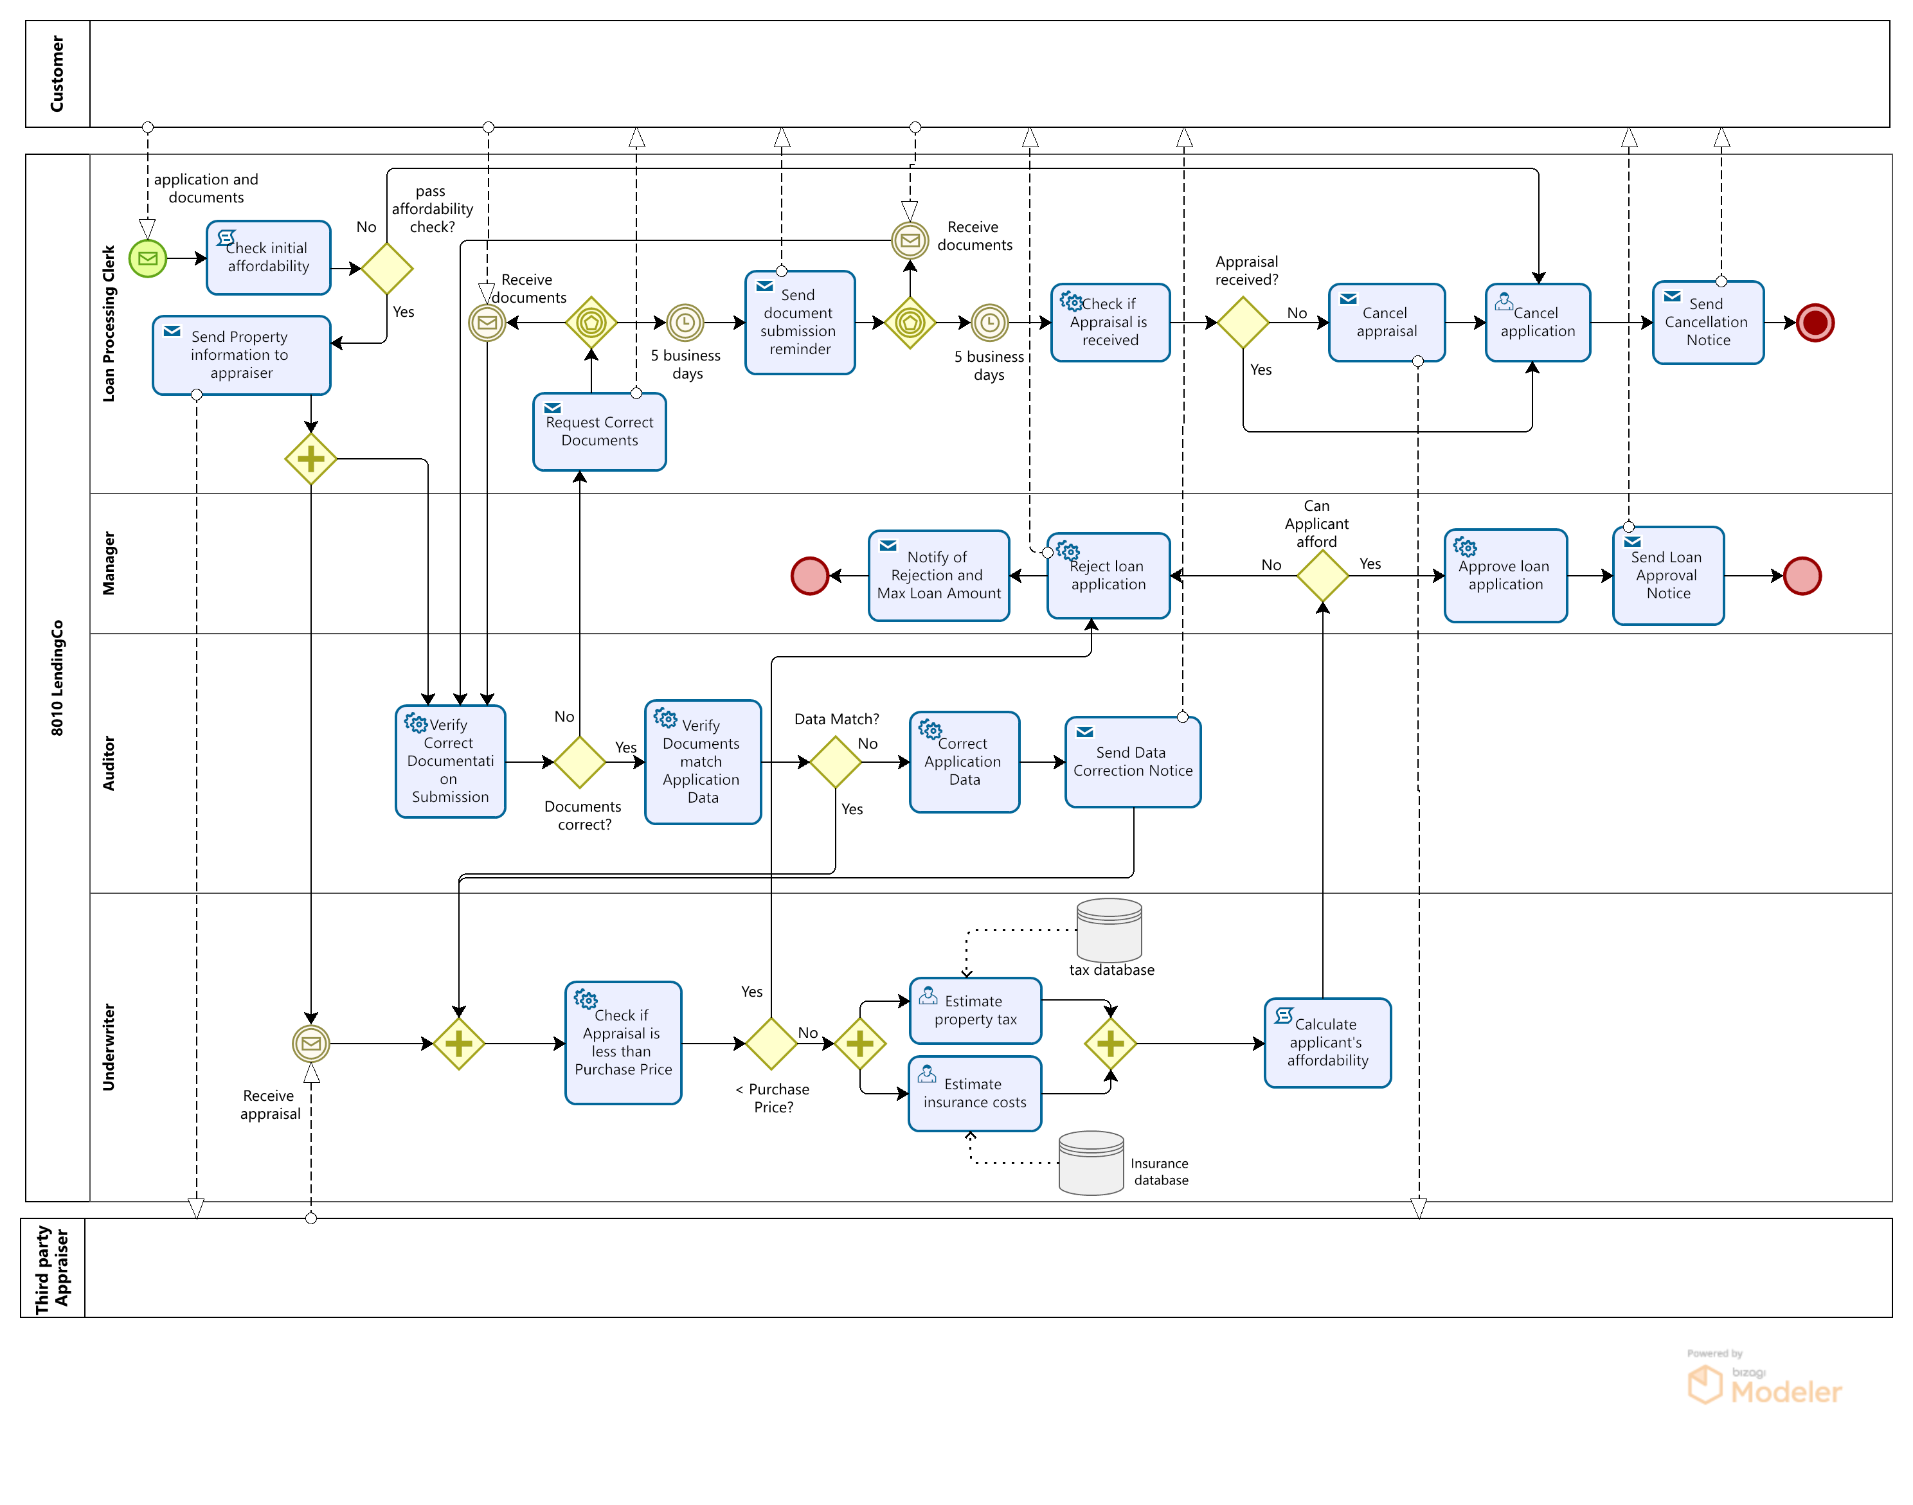
To-Be BUSINESS PROCESS

Slide 10
To-Be BUSINESS PROCESS
Pre-check Affordability
(Debt-to-Income Ratio < 43% based on
Financial Assets,
Income, Current loan EMIs,
Soft check credit score, etc)
Documents Submission Reminder
Automate Specific Tasks using RPA
Automate Tasks
Execute Tasks Parallelly

Slide 11
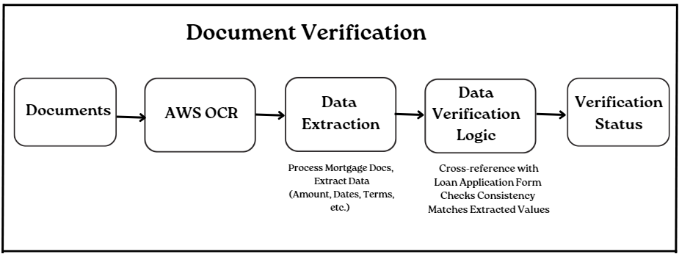
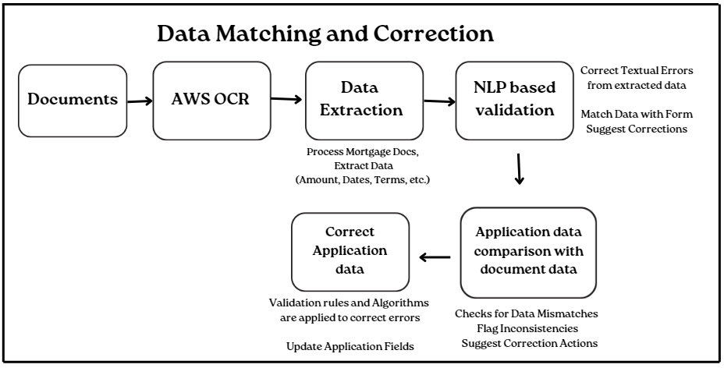
WIREFRAME
When we Receive Loan Application

Slide 12
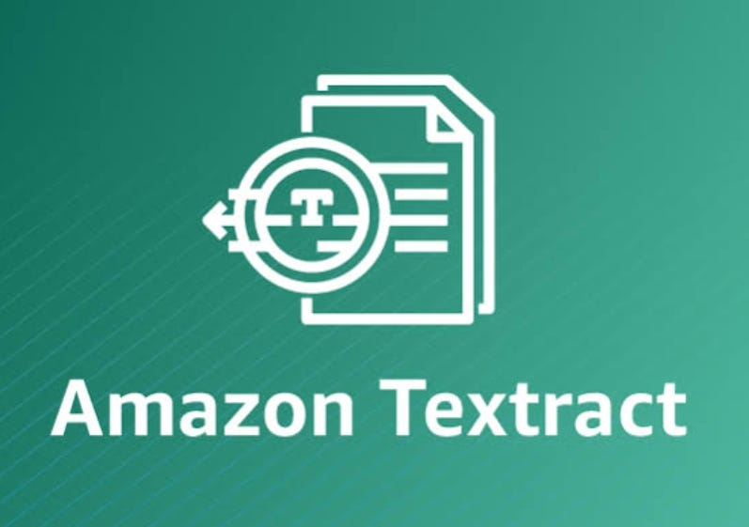

Critiques & Proposed Improvements
Sub-Optimal Task | Critique | Improvement | Impact
Verify Correct Documentation Submission Verify Documents match application data Correct Application Data | Reliance on human intervention | Amazon Textract aid in: Text Mining OCR (Optical Character Recognition) Intelligent Document Processing Natural Language Processing
Estimate Property Tax Estimate Insurance Tax | Tasks sequentially executed | Simultaneous execution of both tasks
Calculate Applicant’s Affordability | Affordability calculated at later stage | Pre-check affordability of applicant by calculating Debt-To-Income Ratio (Monthly Debt/Monthly Income) DTI should be <36% Source
User Tasks (Check if Appraisal value is less than Purchase Price, check if appraisal is received, reject loan application, approve loan application ) | Reliance on human intervention | UiPath (RPA) can be used to automate the tasks
Process Change: Sending documents submission reminder (after 5 days) to the applicant
Underwriting Process lead time
Document verification cycle time
Underwriting Process lead time
Profit and Revenue growth
Cost of underwriting process
+
Underwriting Process lead time

Slide 13
Impediments & Solutions
Impediments | Solutions
Cost of Amazon Textract: Detect Document Text API: $1.50 per 1,000 pages. Analyze Document API: $50 per 1,000 pages for forms and tables Source | Implementing this technology will decrease underwriting process lead time and decrease document verification cycle time Streamlining underwriting and verification processes
Technology effect on employees | A 4-week period of dedicated training to employees for the new process
Manual tasks replaced with RPA can be erroneous | We still have the specific swim lanes with roles for LPC, Manager, Underwriter Cuts down human intervention
Pre-check Affordability can be inaccurate | Checking loan affordability again after receiving verified( documents and appraisal confirmed

Slide 14
References
Debt to Income Ratio
https://www.chase.com/personal/mortgage/education/financing-a-home/how-much-you-can-afford
Cost of Amazon Textract
https://aws.amazon.com/textract/pricing/
Working of Data Correction Automation
Data Correction Automation Working
Automation using UiPath RPA
https://www.uipath.com/platform/automate/ui-and-api-automation
Q&A

Slide 15
Thank You!

